Slide 1
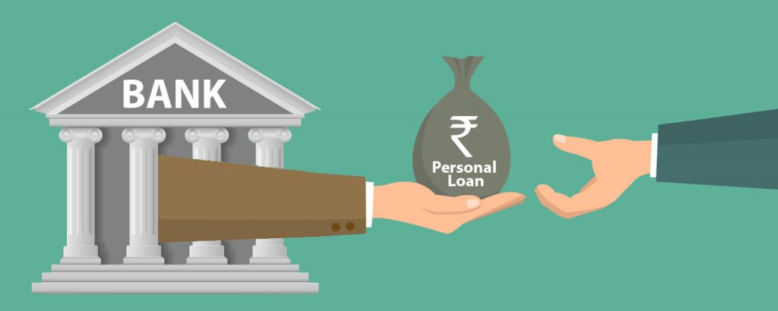
Predictive Analysis of Loan Repayment
Group 7 Members -
M. Sufyan (2020312)
Shivam (2020332)
Sakshi (2020328)
Vanshika (2020413)
Saurabh (2020331)
Sourav Goyal (2020341)
Siddhant (2020338)

Slide 2
Abstract
The due dates on the loans issued by banks are always among the most significant crisis in the evolution of loan lenders toward clients. The higher the loan amount is, the more significant damage will be done if the repayment is not completed.
Banks can avoid suffering from capital losses by appropriately estimating their future costs and adopting choices like determining their surplus budget and conserving their confidence. In this study, we looked into the predictive modelling of client loan repayment patterns by a discrete time markov chain.

Slide 3
Objectives
Model a markov chain to classify loan states and find out loan repayment probability.
Define states, and transition matrix for our Markov chain.
Check whether it satisfies the Markov property or not.
Classify the model as homogeneous (stationary) or non-homogeneous distribution.
Plot the probability matrix of staying in a particular state after 10000 iterations.
Plot the probability matrix of generating risk vs paid loans probability.
Identify the demerits of this method.

Slide 4
Introduction
We are going to use Discrete Time Markov Chain (or DTMC) to analyze a loan repayment dataset and classify different types of loan states along with their probabilistic transitions into other states.
We’ll first prove that our model satisfies the properties of markov chain and then use the model to predict the loan repayment probability. Then we will plot the the probability of staying in a particular state after a large no of iterations.

Slide 5

Different types of Loans
Secured Loans: A type of loan in which the financial institution takes the ownership of an asset that has the same value as the loan amount. It is used as a security (or collateral) for the loan period. Examples are -
Car loan
Property Loan, etc.
Unsecured Loans: A type of loan that is not secured by a collateral. These are more riskier. We are going to use our dataset based on unsecured loans. Examples are -
Personal loan
Student loan

Slide 6



Top Banks who issue Unsecured Loans
HDFC Bank
YES Bank
IDFC First

Slide 7
What is Discrete Time Markov Chain?
A Discrete Time Markov Chain is a stochastic process defined at discrete time and discrete finite states. It has the special property of the next variable/state depending on only the previous state and not any other states in the past.
Essentially,
where p_ij is the probability of going from state i to j.
Notes:
~Sufyan

Slide 8
DATASET
Link To Our Dataset
The data used to for making probability transition matrix is based on the loan taken in the previous years and how many of them were turned out to be good loan, high-risk loan, low-risk loan, were paid up or turned out to be bad one.
Although loans are taken throughout an year and resulting probability transition matrix would be dependent on the time and other economic factors but for our study we have taken them constant and assumption is made that all the loans are taken only at the start of year and throughout the year the probability transition matrix is taken constant.

Slide 9
Constructing Probability Transition Matrix
For constructing probability transition matrix we will use our dataset and count the total number of samples row-wise and divide by each cell in that row for calculating the probability i.e.,
P_{ij} = N _{ij} / ∑^{k}_{j = 1} N _{ij}
where i,j is the cell index and N _{ij} is the number of observations in that cell and ∑^{k}_{j = 1}N _{ij} is the total number of observations in i-th row and k is total number of columns and j goes to 1st column to last columns in this we represent it as k.

Slide 10
Probability Transition Matrix
Loan Type | Good Loan (0) | High Risk Loan (1) | Low Risk Loan (2) | Bad Loan (3) | Paid up (4)
Good Loan (0) | 0.47 | 0.1 | 0.16 | 0.01 | 0.26
High Risk Loan (1) | 0.2 | 0.32 | 0.2 | 0.22 | 0.06
Low Risk Loan (2) | 0.3 | 0.2 | 0.38 | 0.05 | 0.07
Bad Loan (3) | 0 | 0 | 0 | 1 | 0
Paid up (4) | 0 | 0 | 0 | 0 | 1

Slide 11
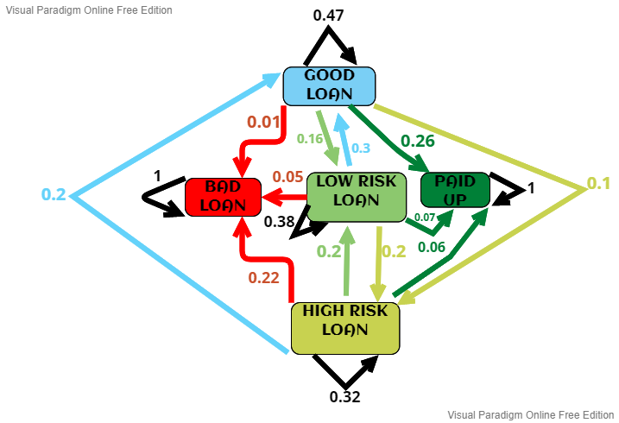
STATE TRANSITION DIAGRAM
Notes:
~Sourav

Slide 12
Problem Modeling
We define 5 states for our problem.
State Space = {Good Loan (0), High Risk Loan (1), Low Risk Loan (2), Bad Loan (3), Paid up (4)}.
Bad Loan: These are the loans that has been defaulted. Once a loan becomes a bad loan, it remains a bad loan forever. Thus, it’s an absorbing state.
Paid up: These are the loans that have been paid successfully. Once a loan has been paid up, it will remain paid up forever. Thus, it’s an absorbing state.

Slide 13
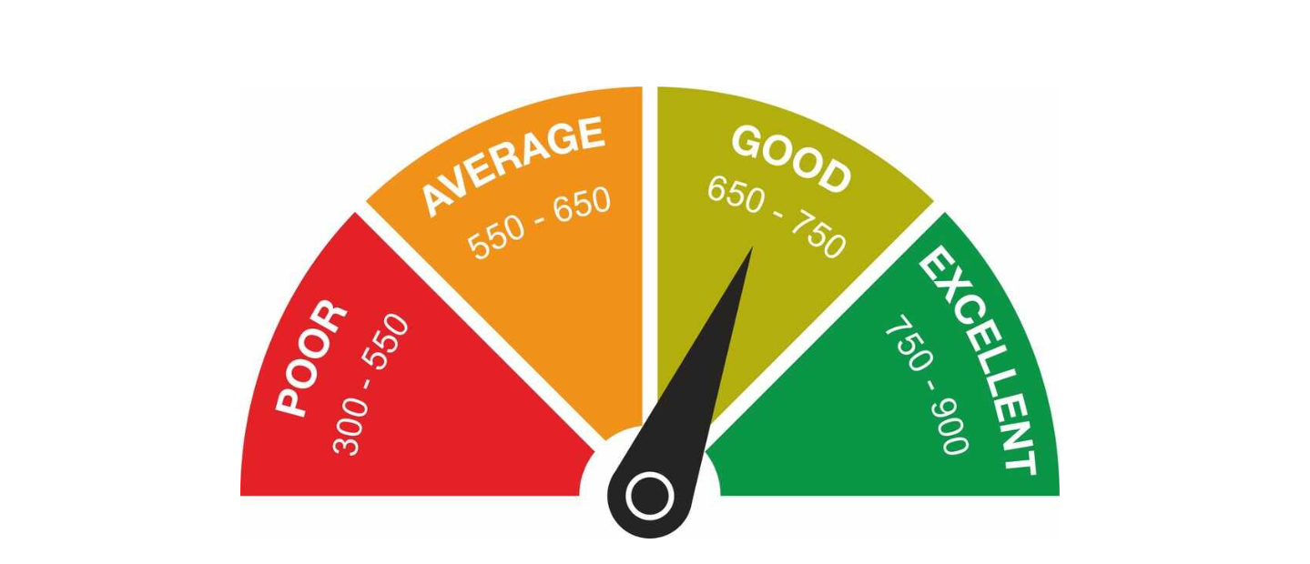
Problem Modeling
A loan is a good loan, a high-risk loan and a low-risk loan is decided on the basis of credit score of a person. Credit score (or Cibil score) of a person is number is usually between 300-900, and it depicts the individual’s ability to repay borrowed credit.
Loans with loan holder having a credit score in range of poor are considered as high-risk
loan while it is in range of average and good are considered as low-risk loans and ones in range of excellent are considered as good loans.
Notes:
~Sakshi

Slide 14
Problem Modeling
We model our problem as a discrete time Markov chain due to the following assumptions:
The status of the loan in the next time step depends only upon the current status of the loan, and the past status of the loan is irrelevant. Thus, our problem follows the Markov property.
The state space is discrete in nature.
Our system is evolving in discrete time. In our case, the time step is 1 month. Thus, we are trying to predict the probability of the status of loan after 1 month.

Slide 15
Problem Modeling
Classes:
There are 3 classes in the problem:
C₁ = {Good Loan (0), High Risk Loan (1), Low Risk Loan (2)}
C₂ = {Bad Loan (3)}
C₃ = {Paid up (4)}
Irreducibility:
The Markov chain is not irreducible because it has more than 1 communicating class.

Slide 16
Problem Modeling
Recurrent States:
If the loan becomes a bad loan, then the loan can never be recovered, and thus, it remains a bad loan. Similarly, if a loan becomes a paid up loan, then the loan has been paid successfully, and thus, it will remain in the paid up status forever. Thus, there are 2 recurrent states: {Bad Loan (3), Paid up (4)}.
Transient States:
If the current status of the loan is Good Loan, High Risk Loan, or Low Risk Loan, then at some point in time, it will definitely become a paid up load, or a bad loan. Thus, there are 3 transient states: {Good Loan (0), High Risk Loan (1), Low Risk Loan (2)}

Slide 17
Problem Modeling
Periodicity:
Each state has a self-loop on itself, i.e., it can reach itself in 1 step. Thus, the period of each state is 1. Thus, every state is aperiodic in nature.
Ergodic:
In a finite state Markov chain, if all the states are recurrent and aperiodic, then it’s an ergodic markov chain. In our problem, since all states of the Markov chain are not recurrent, thus, the markov chain is not ergodic.
Notes:
~Siddhant

Slide 18
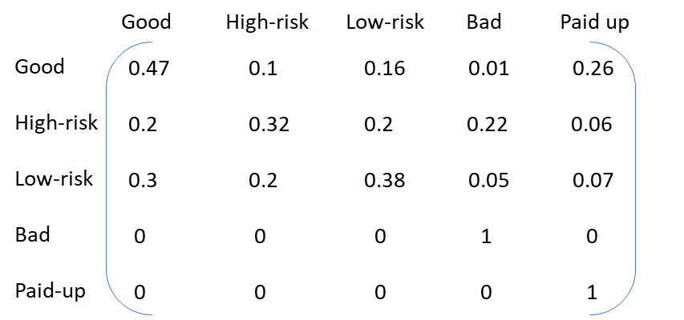
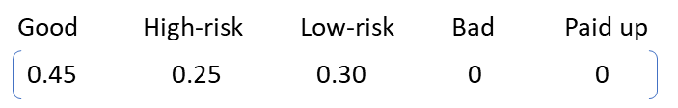
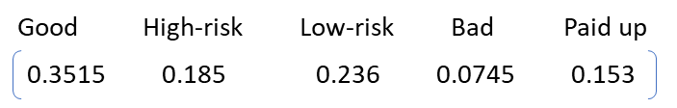
Calculations
Assuming the initial vector of the existence of loans being in a particular category (Good, High-risk, Low-risk, Bad and Paid-up) as [45%, 25%, 30%, 0%, 0%], we can estimate the number of loans falling into each of the five categories, after every 1-month period of time.
This can be represented as: -
X =

Slide 19

Calculations
After calculating the probabilities for the first month, we continue to do the same for the next 24 months, to estimate the probabilities of loans converging to each category. After the first month, the new probability vector is [35.15%, 18.5%, 23.6%, 7.45%, 15.3%]. So, after the first month we can say that the probability of loans becoming bad/default loans is 7.45% and that of loans completing is 15.3%.
Now, doing the same process again for the second month, we multiply the new vector generated with the probability matrix. This can be represented as: -
X =

Slide 20
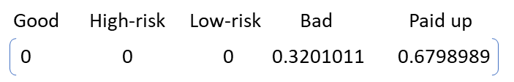
Calculations
After executing the same process for 24 times for 24 months, the generated probability vector is [0.000964%, 0.000496%, 0.000644%, 31.94%, 67.84%]. It can be clearly observed that the number of loans under the category of Good, High-risk and Low-risk are converging to zero and the values of Bad and Paid-up loans is converging to a stable value.
When the values of Good, High-risk and Low-risk finally converge to 0, we get the probabilities that we are looking for, that is, the number of loans that have been Paid-up completely and those which have defaulted/bad loans. This will help us to know the risk and loss in providing the loans.
Stationary probability vector : -

Slide 21
Calculations
As we get the Stationary or finally converged probability vector, it can be said that the probabilities (in percentage) of all the loans falling into the category of Bad/Default loans is 32.01011% and that of Paid-up loans is 67.98989%. Now this stationary vector will remain the same even after multiplying it with the probability matrix any number of times.
This can be represented as: -
X =
Notes:
~Vanshika

Slide 22
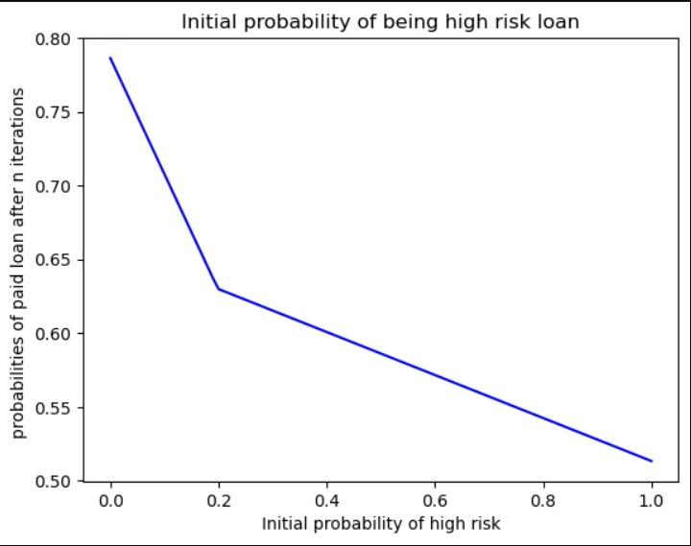
Results and Analysis
Bad and paid up loans are absorbing states so initially their probability would be 0.
We tried all the possible probability values of good, high risk, and low risk loans such that their sum is 1 and we saw that with an increase in probability of high risky loans initially probability of paid loan decreases.

Slide 23
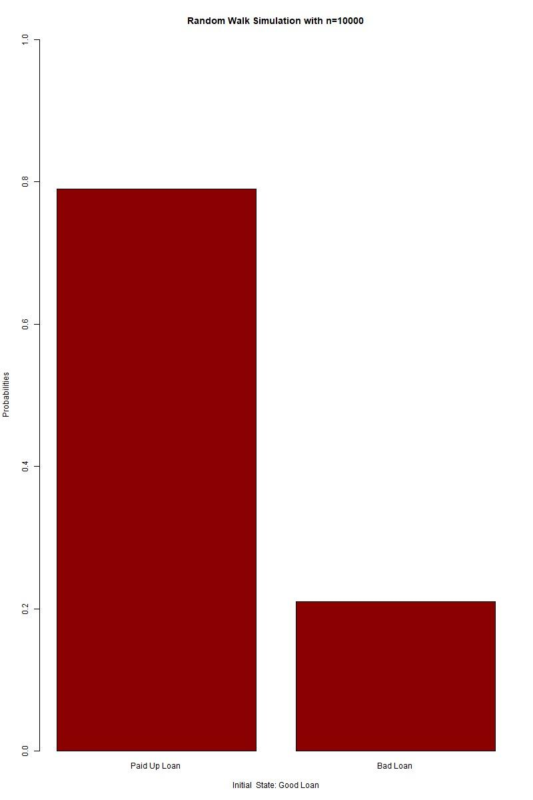
Probabilities of paid and bad loans when initial state is at good loan
0.786
The paid up loan probability after converging is highest equal to 0.786 or 78.6%.
0.263

Slide 24
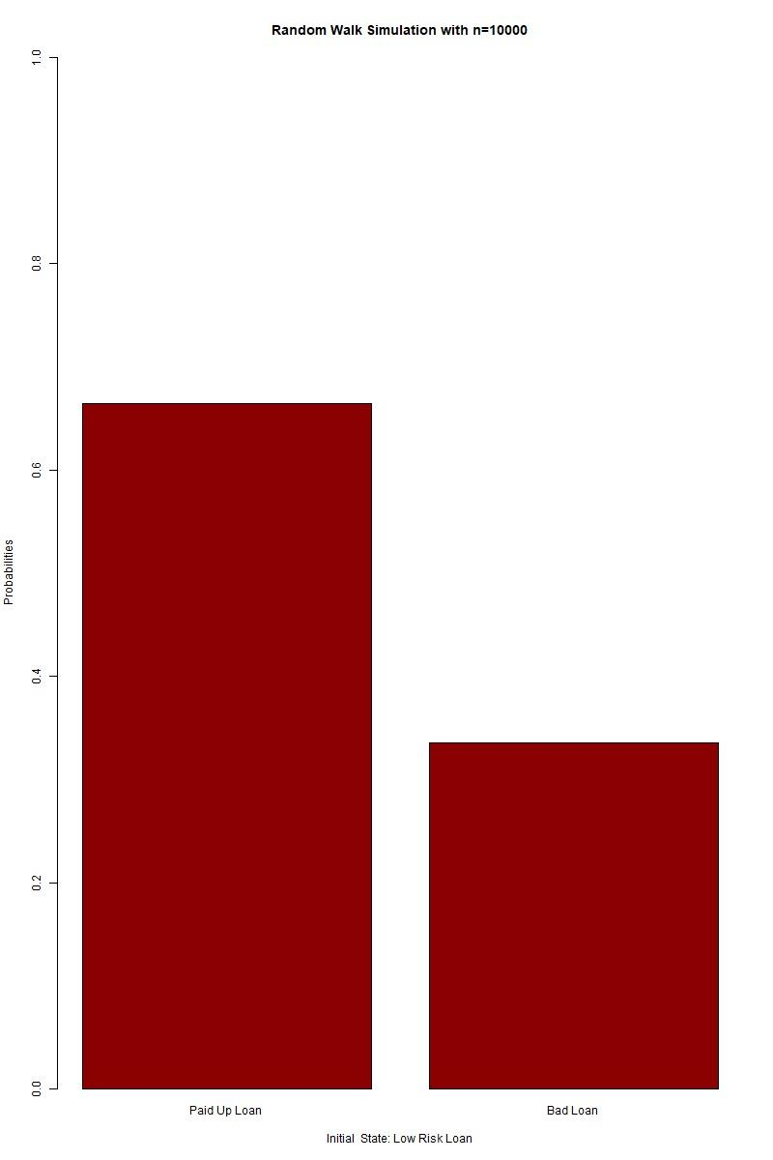
Probabilities of paid and bad loans when initial state is at Low risky loan
0.786
The paid up loan probability after converging is highest equal to 0.658 or 65.8%
0.658
0.341
0.263

Slide 25
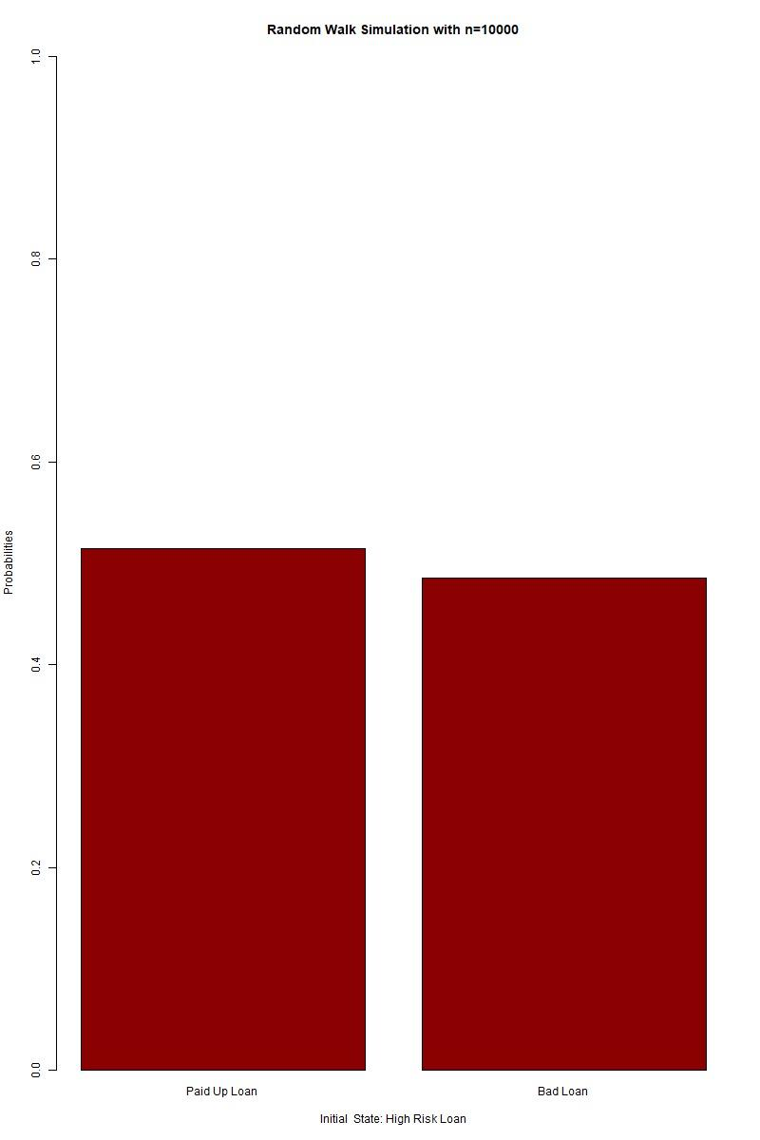
Probabilities of paid and bad loans when initial state is High risky loan
0.786
The paid up loan probability after converging is highest equal to 0.513 or 51.3%
0.513
0.486
0.263

Slide 26
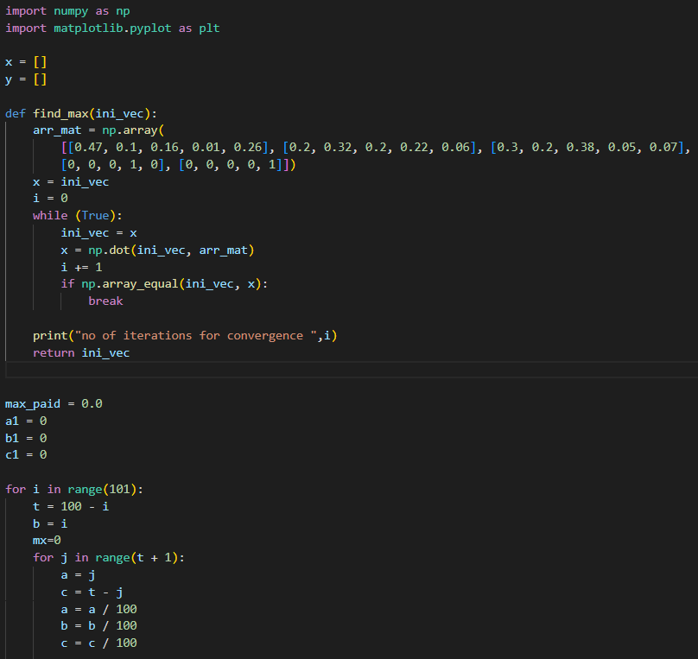
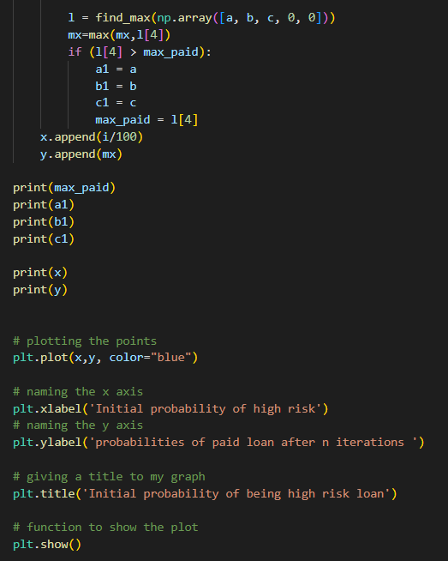
Code for generating risk vs paid loan probabilities
Notes:
~Shivam

Slide 27
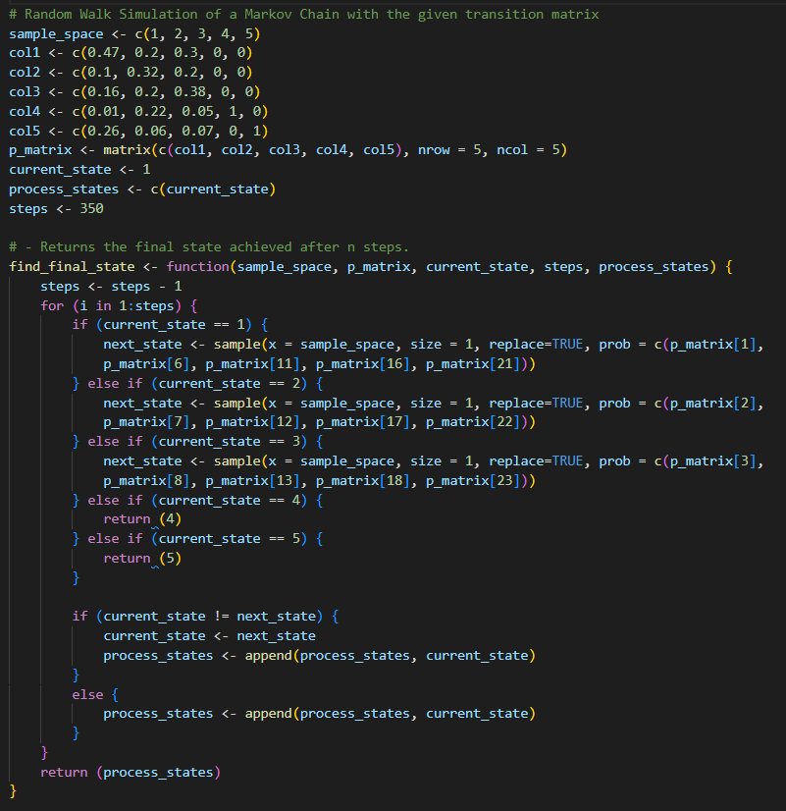
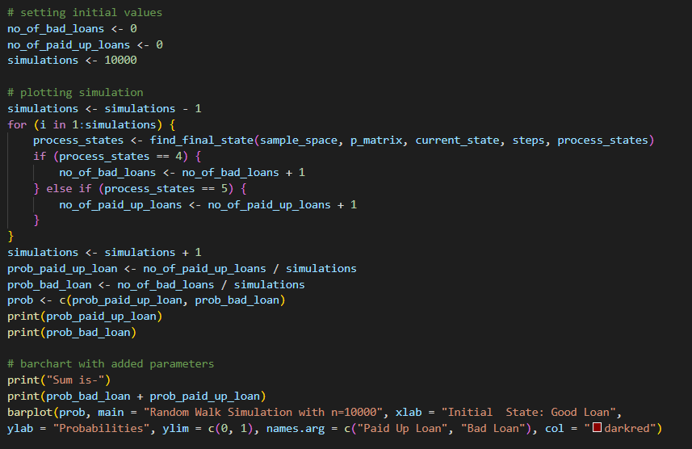
Code for Simulating a Random Walk on our Markov Chain

Slide 28
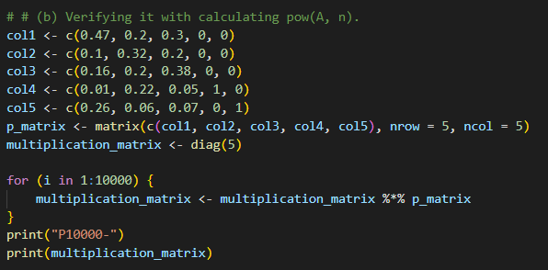
Code For Verifying our Results

Slide 29
Demerits of this method
It needs a lot of previously available data to be able to construct the transition matrix accurately.
The model doesn’t account for a sudden change (like economic recessions) and will give inaccurate results if something like that happens.

Slide 30

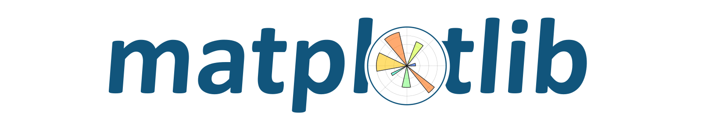


Tools Used For the Analysis

Slide 31
References
(PDF) Forecasting the loan repayment behavior by banks loan receivers using discrete Markov chain. Available from: https://www.researchgate.net/publication/335125226_Forecasting_the_loan_repayment_behavior_by_banks_loan_receivers_using_discrete_Markov_chain [accessed Dec 04 2022].
Difference Between Secured and Unsecured Loan - BankBazaar. https://www.bankbazaar.com/home-loan/secured-vs-unsecured-loan.html [accessed Dec 04 2022]
Unsecured Loans Eligibility, Interest Rates, Types & Benefits - BankBazaar. https://www.bankbazaar.com/personal-loan/unsecured-loans.html [accessed Dec 04 2022]
Solve a business case using simple Markov Chain - Analytics Vidhya. https://www.analyticsvidhya.com/blog/2014/07/solve-business-case-simple-markov-chain/ [accessed Dec 03 2022]

Slide 32
Thank You
Notes:
~Sufyan

